Slide 1
Train Visual Inspection Models and Deploy on Azure
Mohammad Muquit, Ying Liu, Mike Simcock, Paul Huxel, Ted Sjodin
Jan 21, 2024

Slide 2
Overview
Develop Model
Deploy to Azure
Inference Demo

Slide 3
Overview
Develop Model
Deploy to Azure
Inference Demo

Slide 4

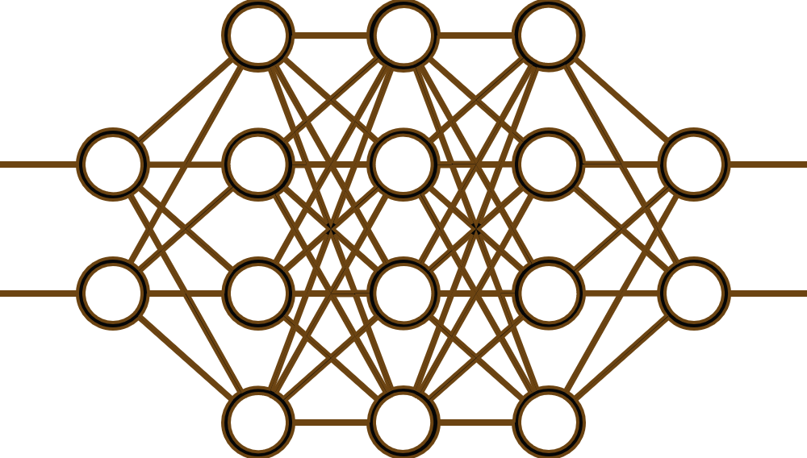
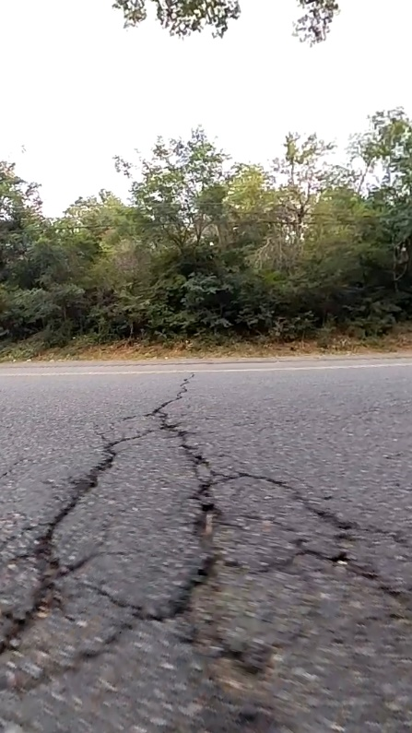



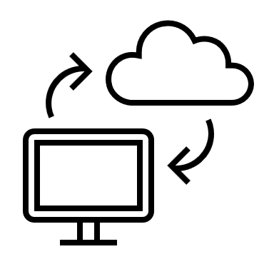

Overview
Development Model
Anomaly Detector AI Model
Example:
Detect Road Surface Cracks
Azure Deployment
Docker Image
FCDD Algorithm
GoogleNet
Inference Demo
RESTful API
MATLAB on Backend

Slide 5
Overview
Develop Model
Deploy to Azure
Inference Demo

Slide 6
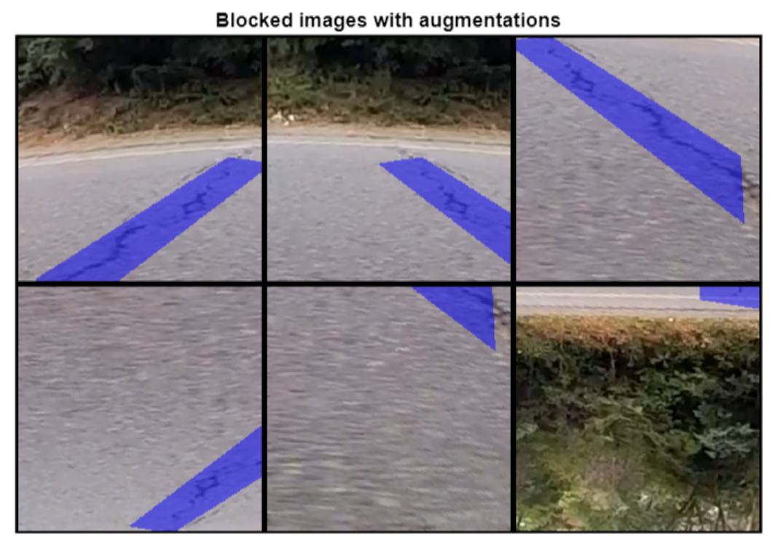
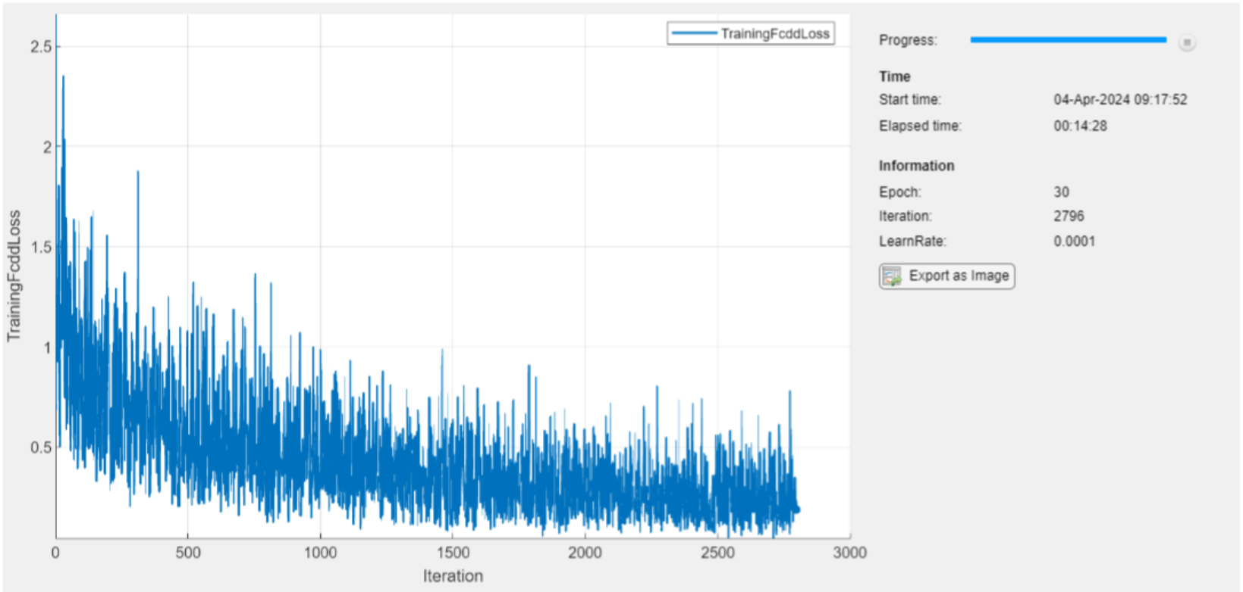
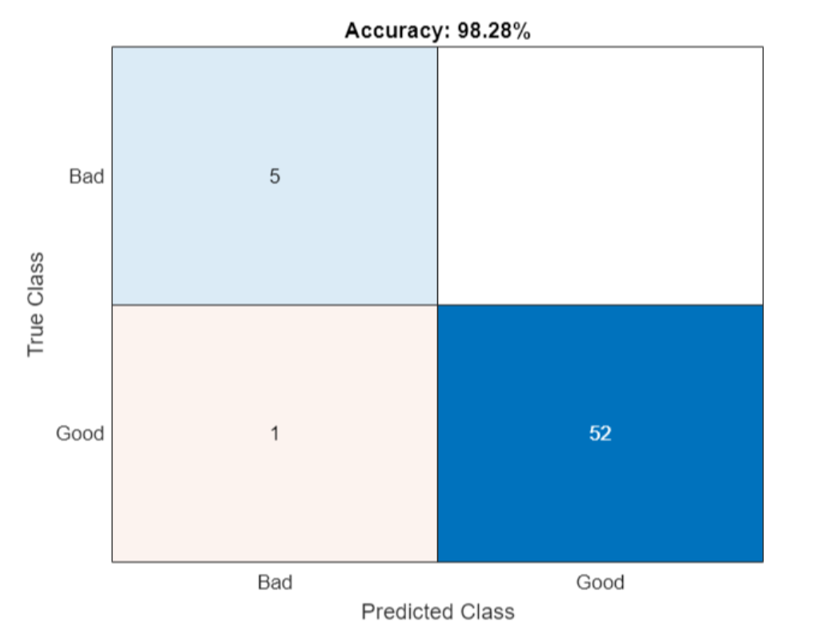
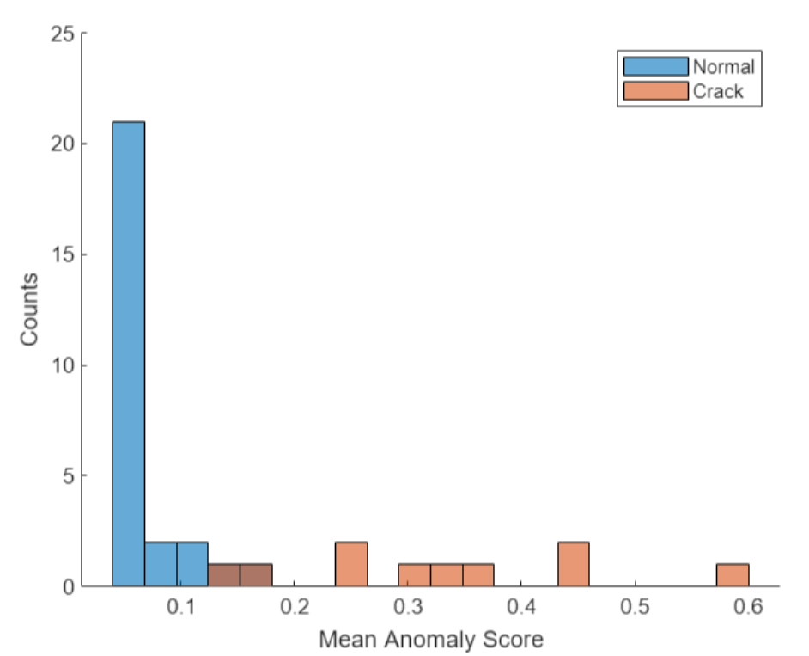
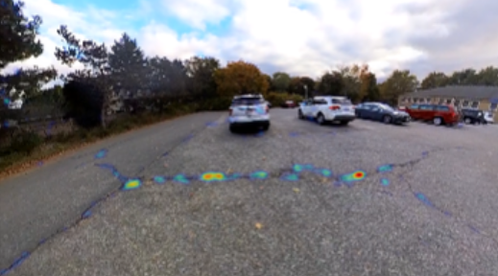
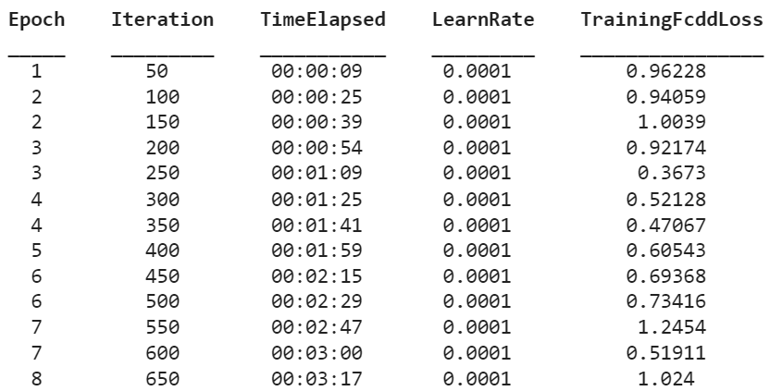
Develop a Crack Detection Model
Imager Data Preparation
Train Model/Calibrate Detector
Evaluate Detector
block image datastore
Crack area mask
augmentation
Data size
-Normal: 265
-Crack: 25
FCDD Algorithm
GoogleNet as backbone
Calibrate for anopmaly threshold
Heatmap display
98.3% accuracy

Slide 7
Overview
Develop Model
Deploy to Azure
Inference Demo

Slide 8
Workflow for Deploying A Docker Image on Azure
Deploy Docker Image on Azure
Lots of small things to do for beginning!
Push the Docker Image to this container registry
(Azure Repository)
Set Docker Environment
Create Docker Image
Compile the
Docker Image on MATLAB (Local)
Set Azure Environment
Get a Docker Account
Create a Container Instance of the
Azure Repository
Get an Azure
Account
Tag the
Docker Image
to the Repository
Install Docker Desktop
Create resource group and a container registry
Deploy the Container Instance Fetch the FQDN
Create a
Docker repository
On Docker Hub
Push the
Docker Image to
Docker Repository
RESTful API call to function Using the Azure FQDN
One time job
Every time job
If you want to save the microservice in Docker Desktop

Slide 9
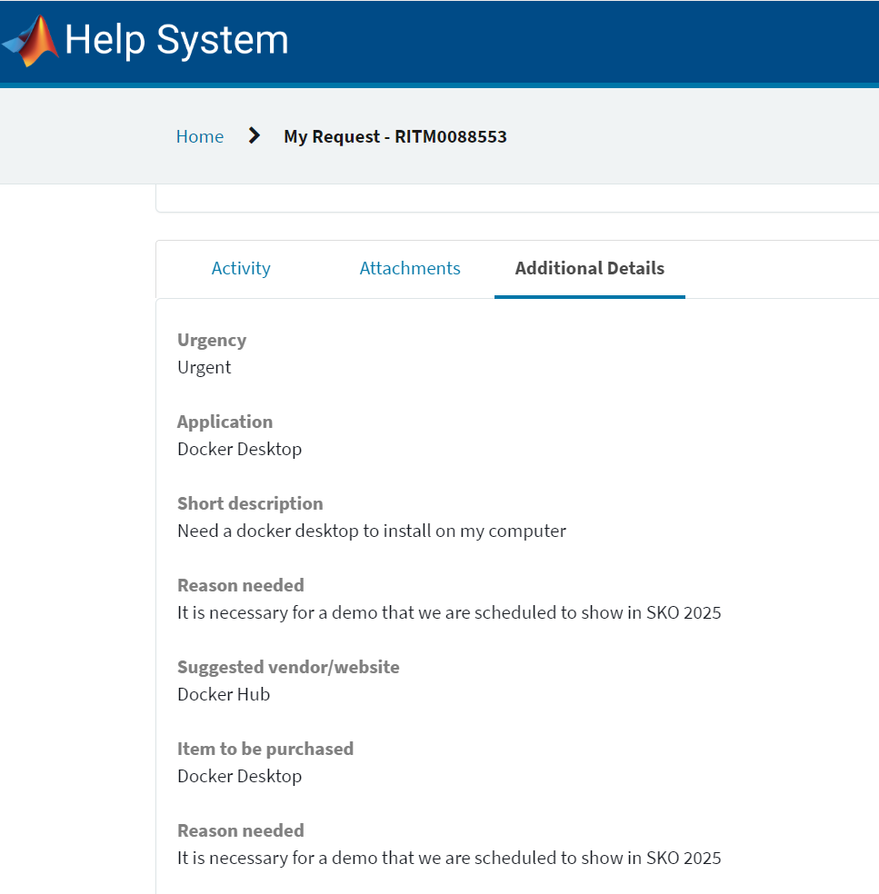
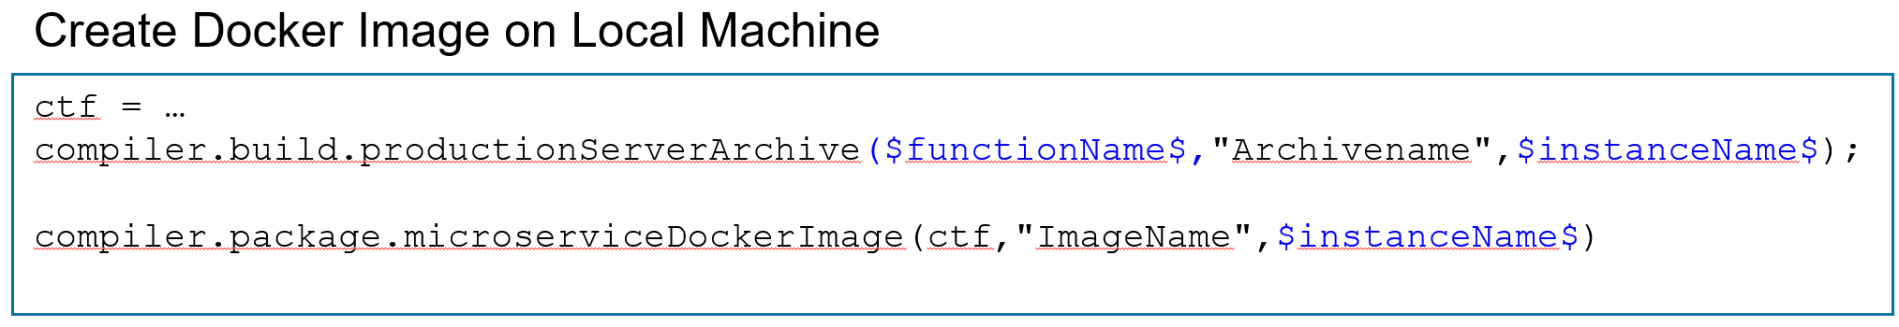
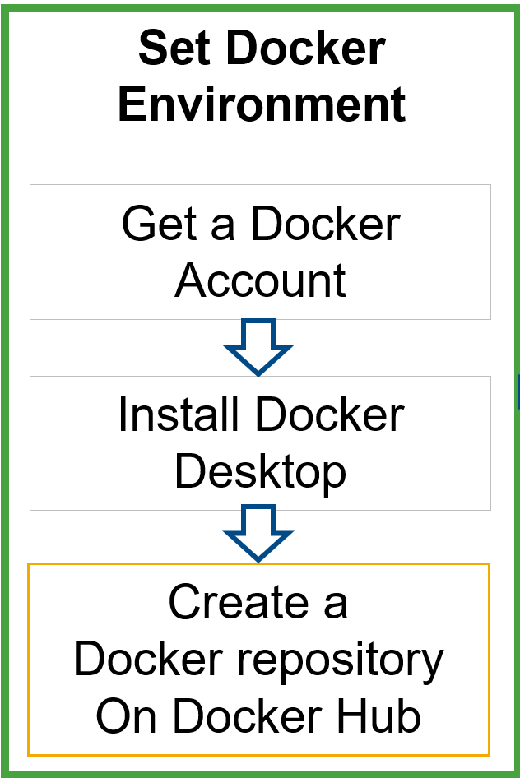
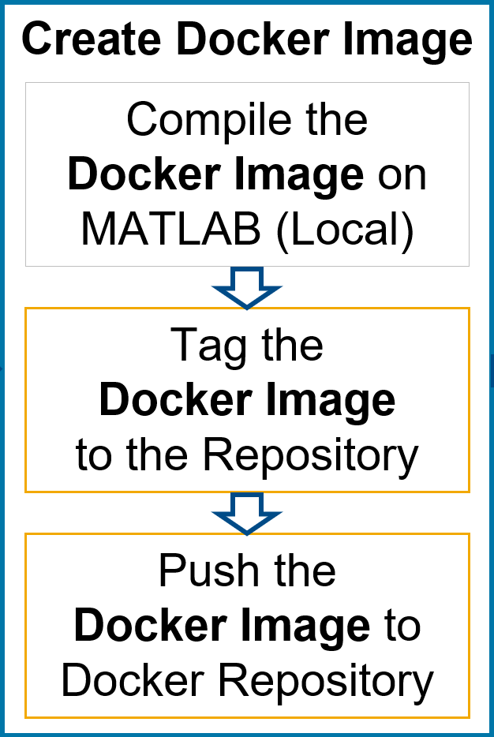
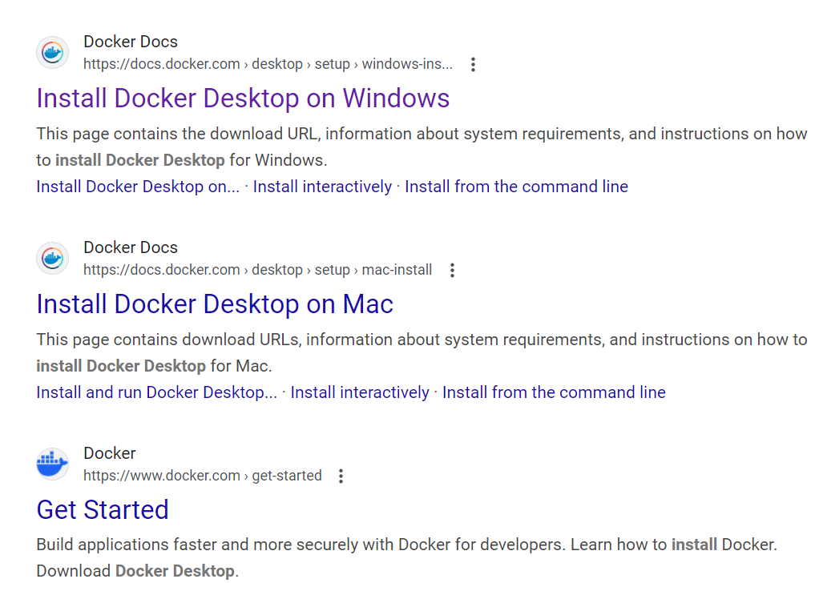
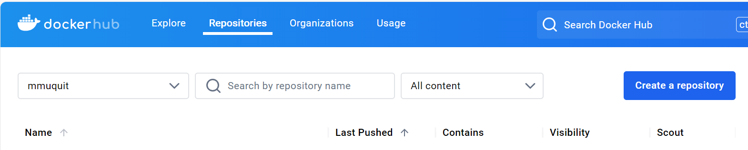
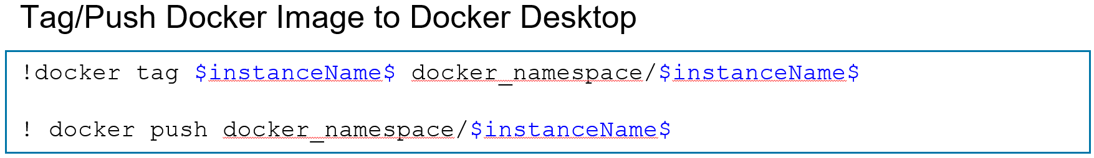
Set Docker Environment/ Create Docker Image

Slide 10
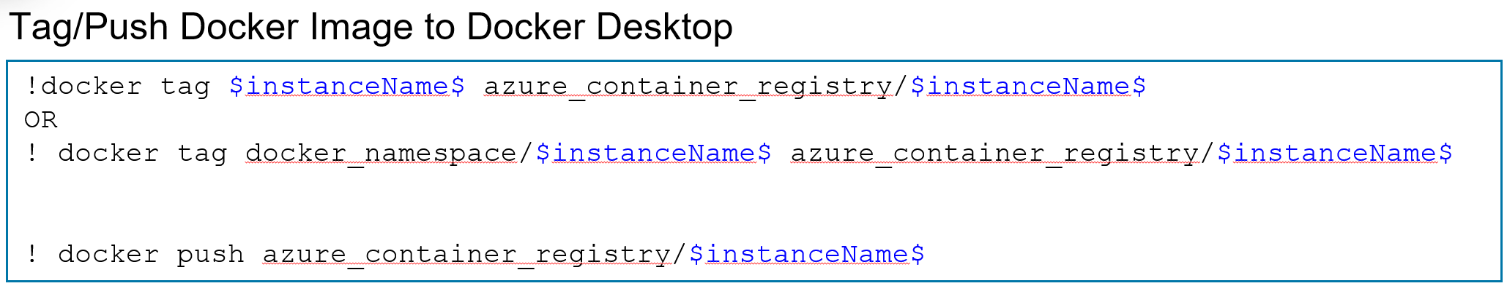
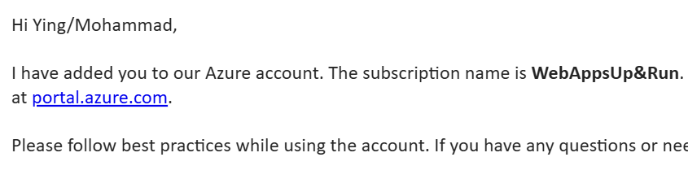
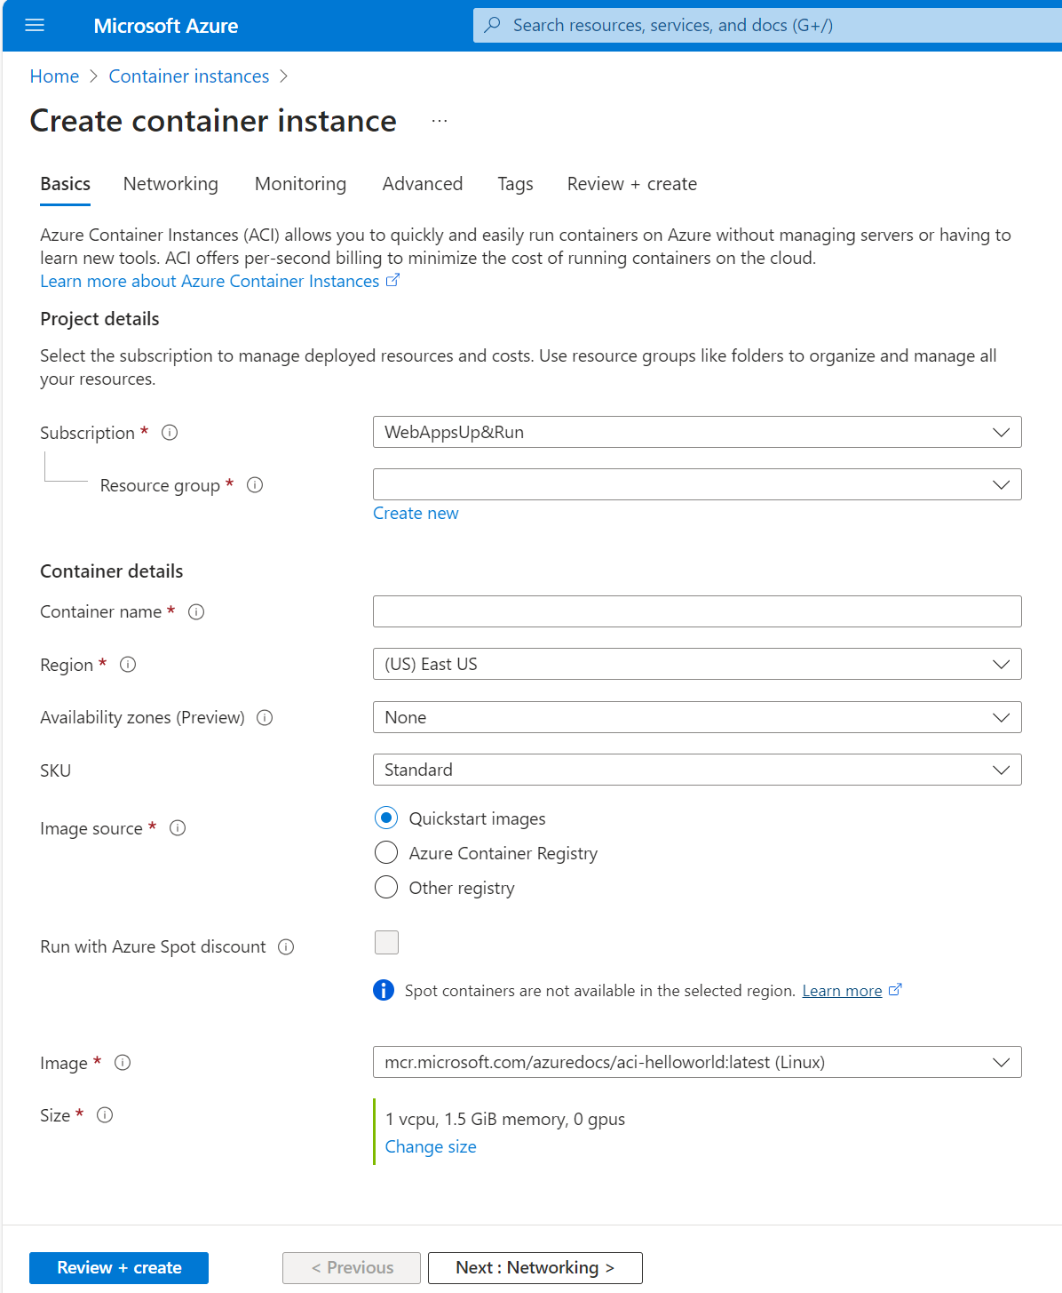
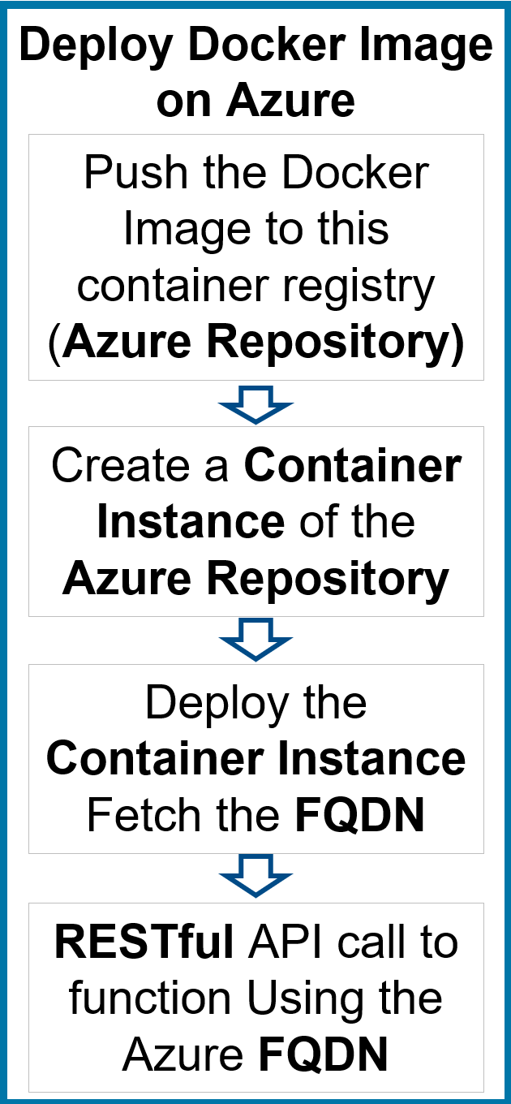
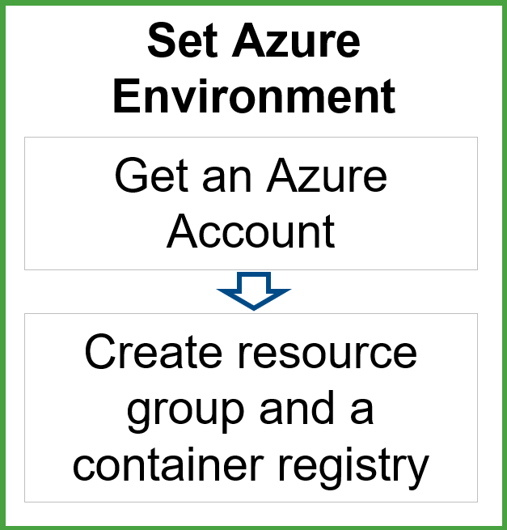
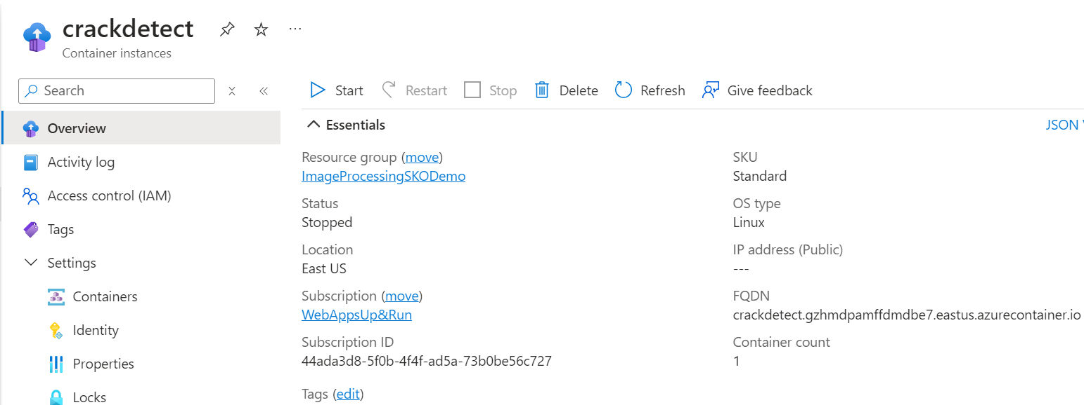
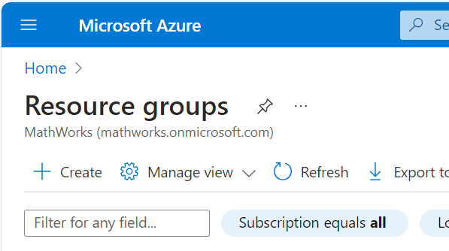
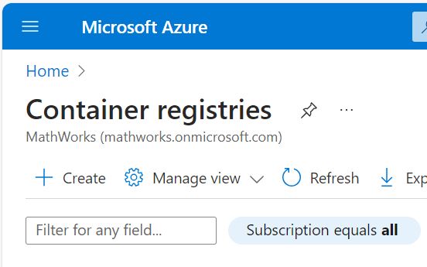
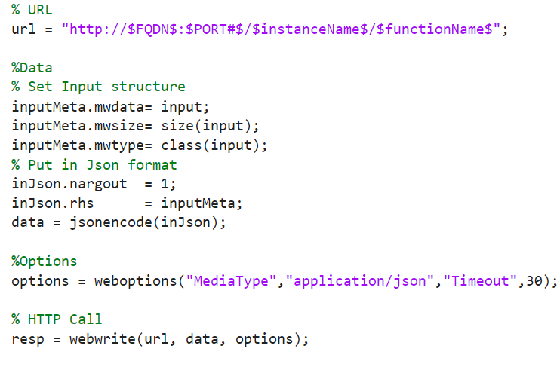
Set Azure Environment
Request by email to appropriate person

Slide 11
Overview
Develop Model
Deploy to Azure
Inference Demo

Slide 12
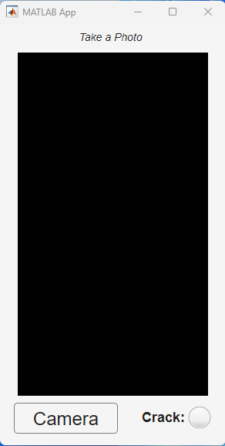
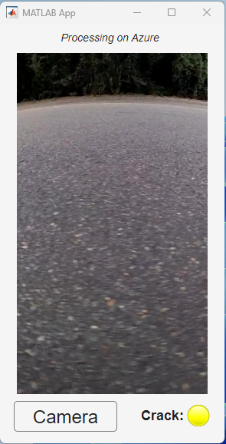
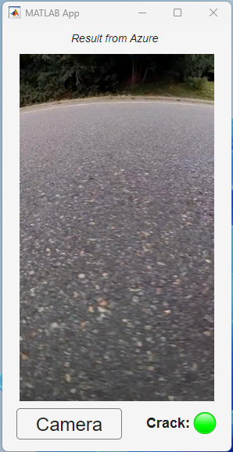
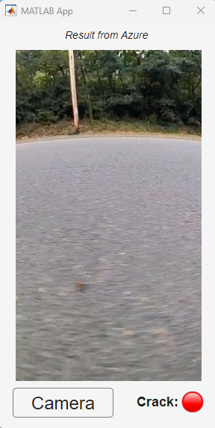
App Overview For Demo
Results got from Azure
Initial screen
Request sent to Azure

Slide 13
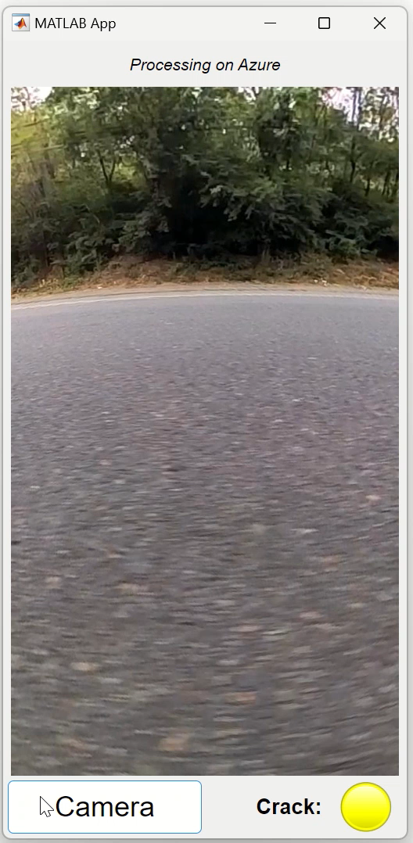
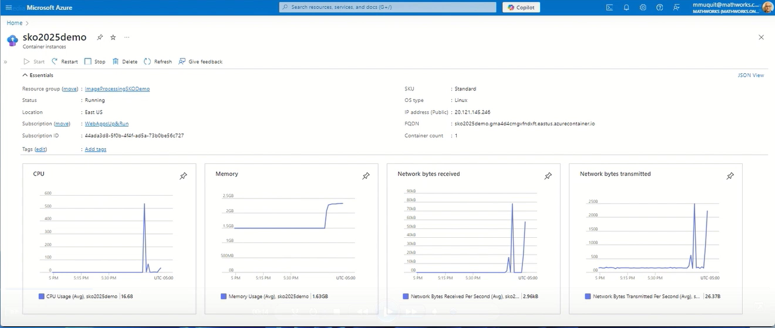
Demo
DMM
Algorithm developed on MATLAB running backend on Azure
Any frontend application can call using RESTful API

Slide 14
Thank
You

